Slide 1
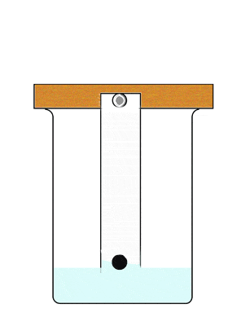
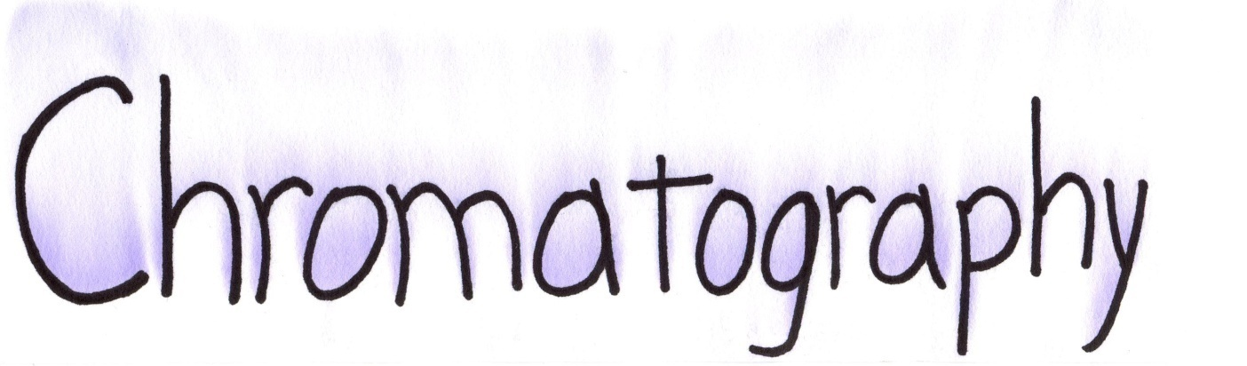
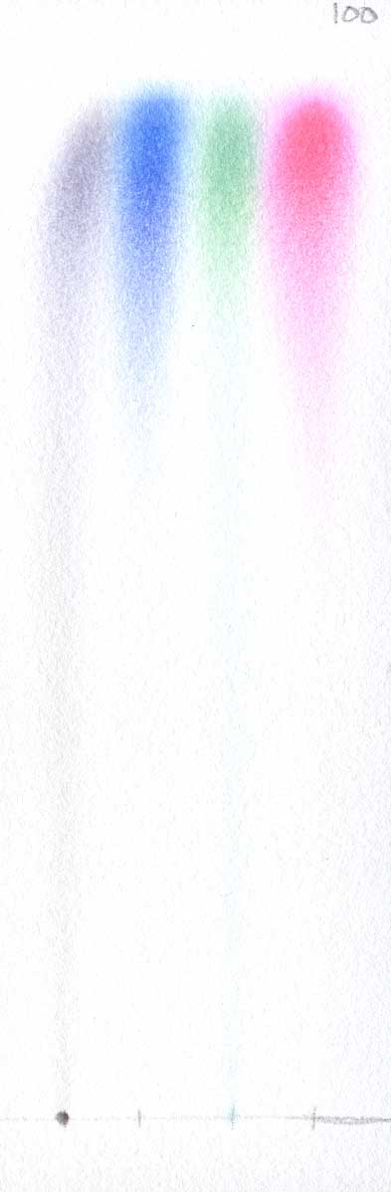
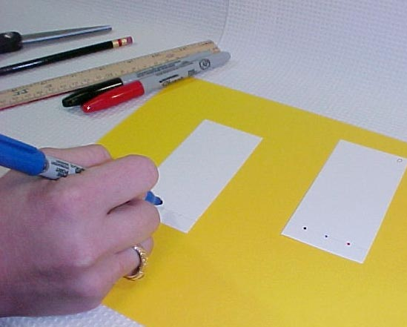

Slide 2
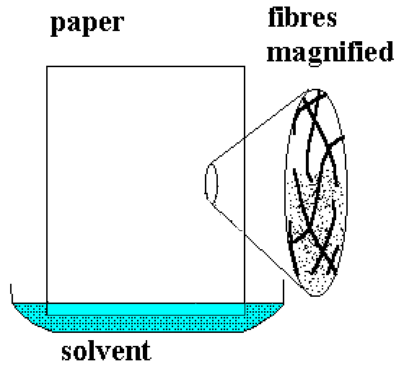

Slide 3
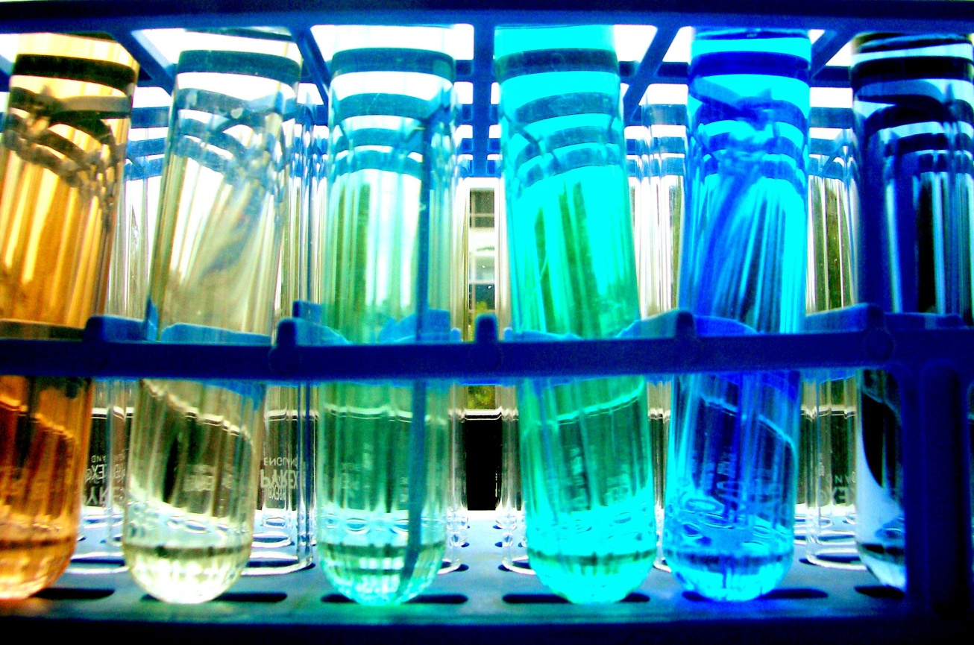
What is Chromatography?
Derived from the Greek word Chroma meaning colour, chromatography provides a way to identify unknown compounds and separate mixtures

Slide 4
What is Chromatography?
Chromatography is a technique for separating mixtures into their components in order to analyze, identify, purify, and/or quantify the mixture or components.
Analyze
Identify
Purify
Quantify
Separate
Mixture
Components

Slide 5
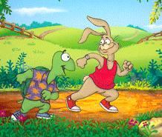
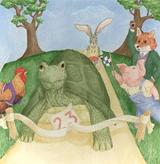
“Simply, we can think of chromatography as being analagous to a race between chemical compounds. At the starting line, all the participating substances are mixed together; however as the race progresses, those materials that have a preference for the moving phase will slowly pull ahead of those substances that prefer to remain in the stationary phase. Finally, at the completion of the race, all the participants will be separated, each crossing the finish line at different times.

Slide 6
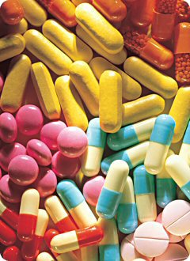
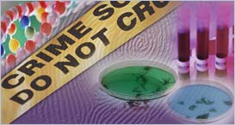
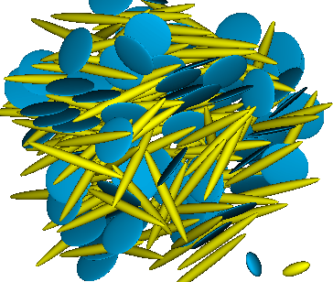
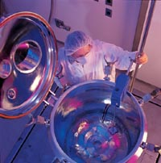
Applications of Chromatography
Forensics
Research
Pharmaceutical industry
Notes:
Chromatography is a technique for
separating mixtures of compounds
identifying unknown compounds
establishing the purity or concentration of compounds
monitoring product formation in the pharmaceutical and biotechnology industries
Chromatography is widely used by forensic teams to analyse blood and urine samples for drugs, for paint analysis and testing for the presence of explosives. Most chromatography uses modern instrumentation and involves placing the sample to be analysed on a support (paper or silica) and transporting it along a mobile phase. The mobile phase can be a liquid (liquid chromatography) or a gas (gas chromatography).

Slide 7
Uses for Chromatography
Chromatography is used by scientists to:
Analyze – examine a mixture, its components, and their relations to one another
Identify – determine the identity of a mixture or components based on known components
Purify – separate components in order to isolate one of interest for further study
Quantify – determine the amount of the a mixture and/or the components present in the sample

Slide 8
Chromatography is widely used by forensic teams to analyse blood and urine samples for drugs, for paint analysis and testing for the presence of explosives

Slide 9
Uses for Chromatography
Real-life examples of uses for chromatography:
Pharmaceutical Company – determine amount of each chemical found in new product
Hospital – detect blood or alcohol levels in a patient’s blood stream
Law Enforcement – to compare a sample found at a crime scene to samples from suspects
Environmental Agency – determine the level of pollutants in the water supply
Manufacturing Plant – to purify a chemical needed to make a product

Slide 10
Definition of Chromatography
Detailed Definition:
Chromatography is a laboratory technique that separates components within a mixture by using the differential affinities of the components for a mobile medium and for a stationary adsorbing medium through which they pass.
Terminology:
  Differential – showing a difference, distinctive
  Affinity – natural attraction or force between things
  Mobile Medium – gas or liquid that carries the components (mobile phase)
  Stationary Medium – the part of the apparatus that does not move with the sample (stationary phase)

Slide 11
Definition of Chromatography
Simplified Definition:
Chromatography separates the components of a mixture by their distinctive attraction to the mobile phase and the stationary phase.
Explanation:
  Compound is placed on stationary phase
  Mobile phase passes through the stationary phase
  Mobile phase solubilizes the components
  Mobile phase carries the individual components a certain distance through the stationary phase, depending on their attraction to both of the phases

Slide 12
Chromatography
Works by allowing the molecules present in the mixture to distribute themselves between a stationary and a mobile medium.
Molecules that spend most of their time in the mobile phase are carried along faster.

Slide 13
Illustration of Chromatography
Stationary Phase
Separation
Mobile Phase
Mixture
Components
Components | Affinity to Stationary Phase | Affinity to Mobile Phase
Blue | ---------------- | Insoluble in Mobile Phase
Black | ✓ ✓ ✓ ✓ ✓ ✓ | ✓ ✓
Red | ✓ ✓ | ✓ ✓ ✓ ✓ ✓
Yellow | ✓ | ✓✓✓ ✓ ✓ ✓ ✓ ✓ ✓ ✓ ✓

Slide 15
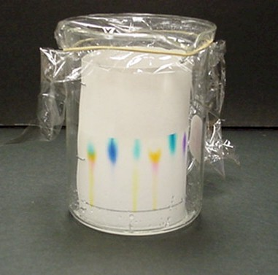
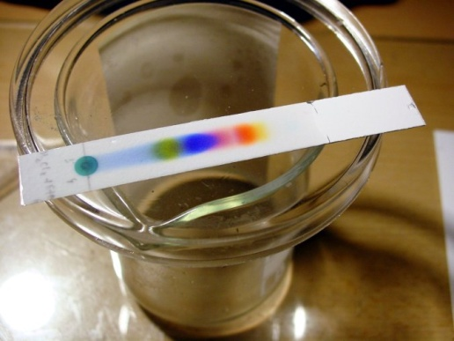

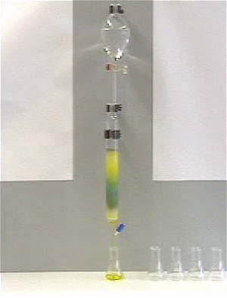
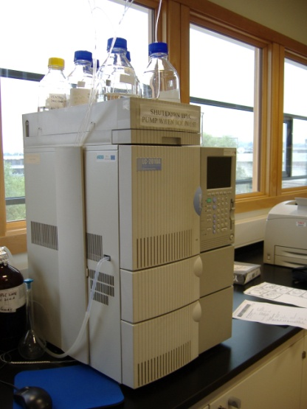
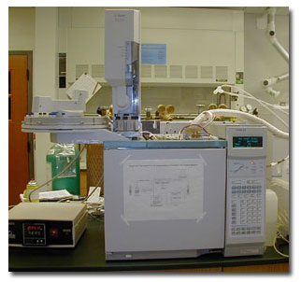
Types of Chromatography…
Thin layer
Paper
HPLC
Gas
Column
Notes:
Most chromatography uses modern instrumentation and involves placing the sample to be analysed on a support (paper or silica) and transporting it along a mobile phase. The mobile phase can be a liquid (liquid chromatography) or a gas (gas chromatography).

Slide 16
Types of Chromatography
Types of Chromatography
Liquid Chromatography – separates liquid samples with a liquid solvent (mobile phase) and a column composed of solid beads (stationary phase)
Gas Chromatography – separates vaporized samples with a carrier gas (mobile phase) and a column composed of a liquid or of solid beads (stationary phase)
Paper Chromatography – separates dried liquid samples with a liquid solvent (mobile phase) and a paper strip (stationary phase)
Thin-Layer Chromatography – separates dried liquid samples with a liquid solvent (mobile phase) and a glass plate covered with a thin layer of alumina or silica gel (stationary phase)

Slide 17
Principles of Paper Chromatography
Capillary Action – the movement of liquid within the spaces of a porous material due to the forces of adhesion, cohesion, and surface tension. The liquid is able to move up the filter paper because its attraction to itself is stronger than the force of gravity.
Solubility – the degree to which a material (solute) dissolves into a solvent. Solutes dissolve into solvents that have similar properties. (Like dissolves like) This allows different solutes to be separated by different combinations of solvents.
Separation of components depends on both their solubility in the mobile phase and their differential affinity to the mobile phase and the stationary phase.

Slide 18
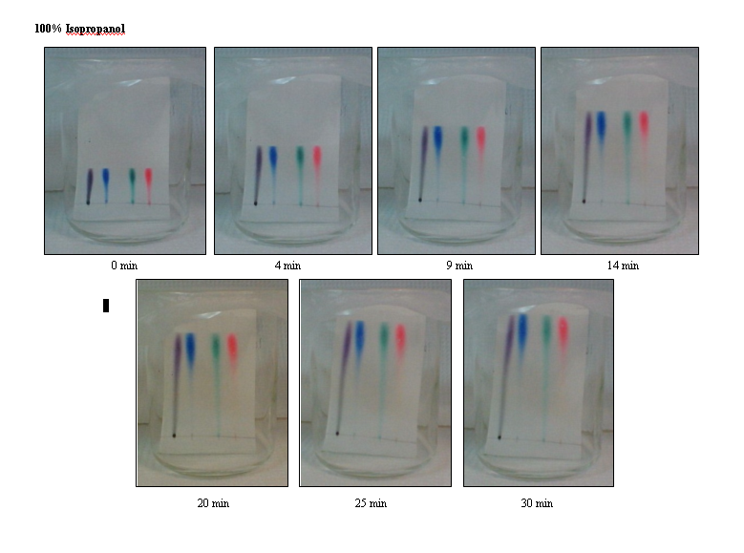
Developing the Chromatograms

Slide 19
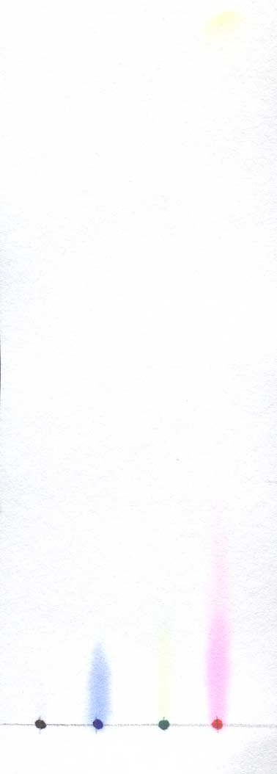
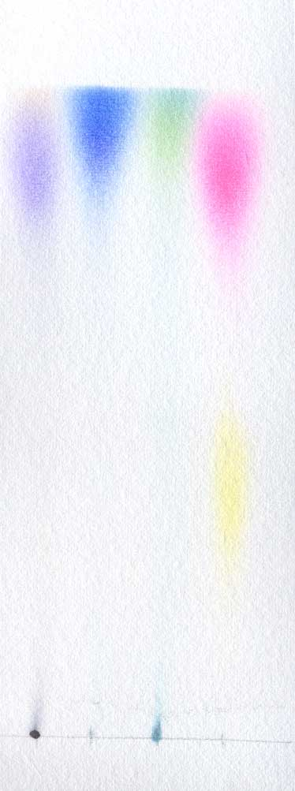
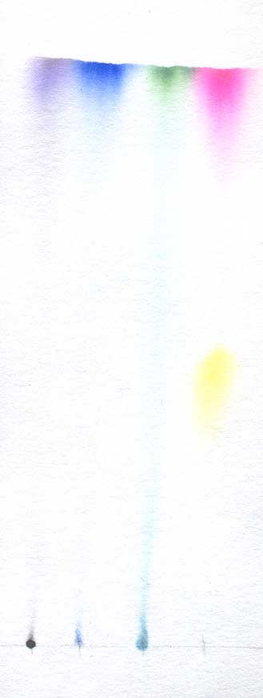
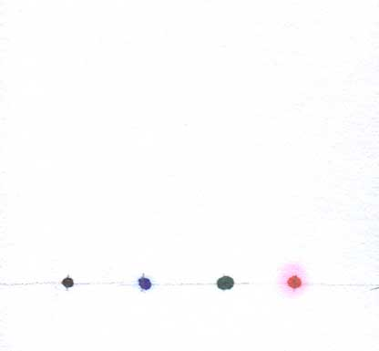
Red Dye
1. Dyes separated – red and yellow
2. Yellow –soluble in low concentrations of isopropanol and
less soluble in high concentrations of isopropanol
3. Red – slightly soluble in low concentrations of isopropanol, and more soluble in concentrations of isopropanol >20%
0%
20%
50%
70%
100%
Concentration of Isopropanol

Slide 20
Gas Liquid Chromatography
Here the mobile phase is an unreactive gas ( eg Nitrogen) flowing through a tube.
And the stationary phase is an involatile liquid held on particles of a solid support.

Slide 21
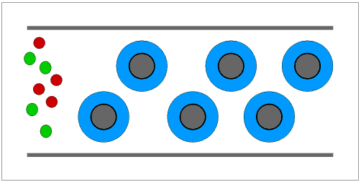
In the animation below the red molecules are more soluble in the liquid (or less volatile) than are the green molecules.

Slide 22
Injection
port
Recorder
Oven
Detector
Column
Nitrogen
cylinder

Slide 23
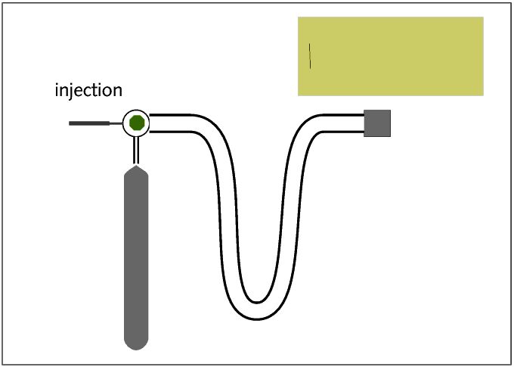

Slide 24
Thin Layer Chromatography
Here the mobile phase is a liquid
Flowing past a thin layer of powder on a solid support.
Substances that are less attracted to the solid or are more soluble in the liquid move faster.
And so move further up the plate by the time that the process has been stopped by taking the plate out of the liqiud. - larger Rf

Slide 25
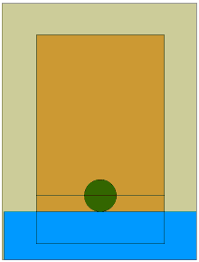

Slide 26
R_{f} = distance moved by substance
distance moved by solvent front
For substances that are very soluble in the liquid R_{f} will be close to ....
1
For substances that are rather insoluble in the liquid R_{f} will be close to ....
0

