Slide 1
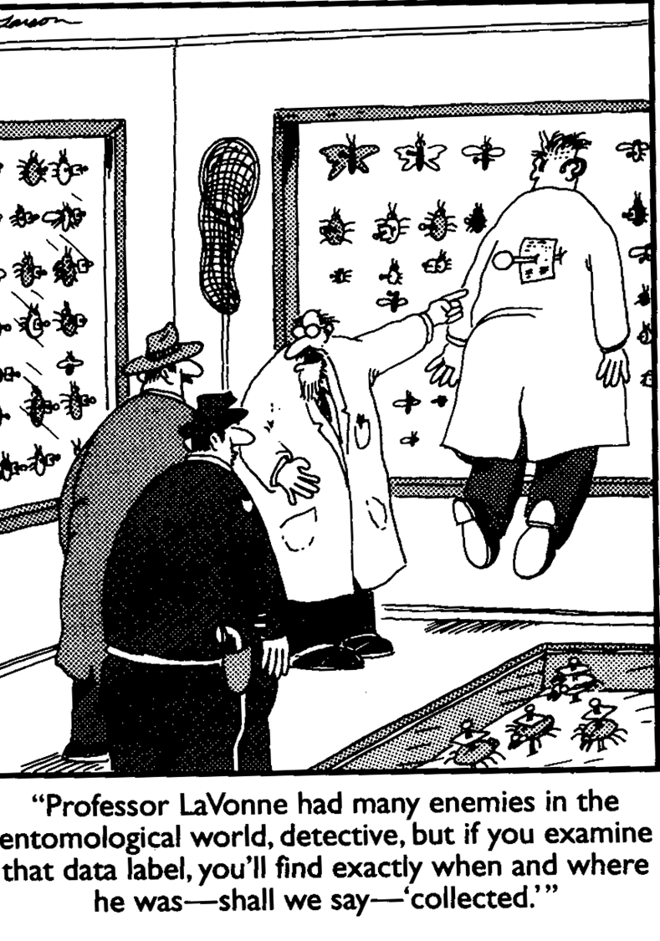
Forensic Entomology

Slide 2
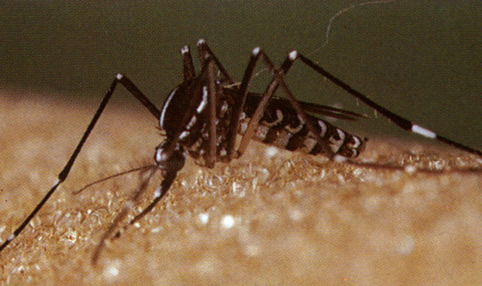
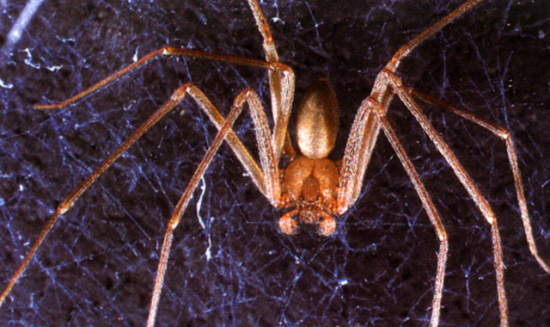
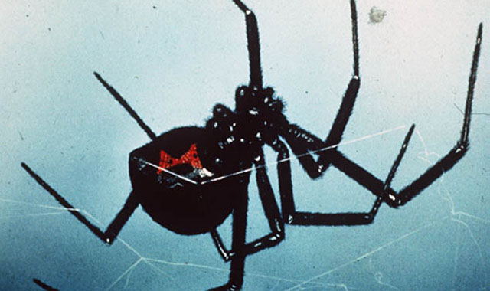
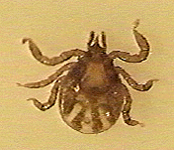
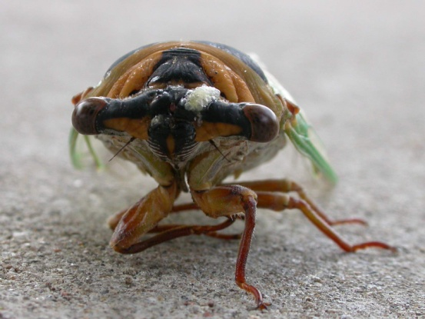
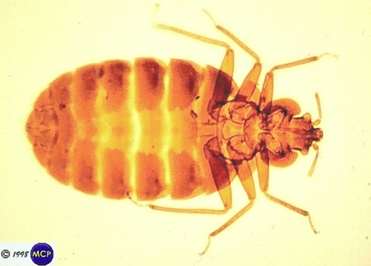
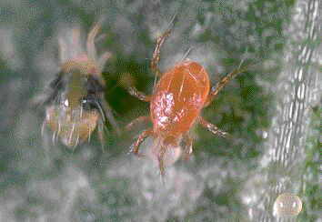
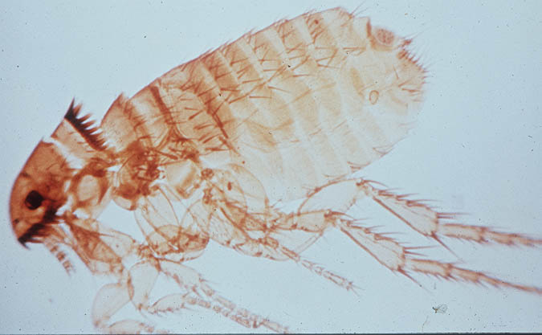
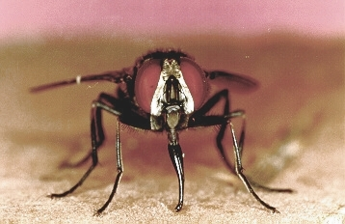
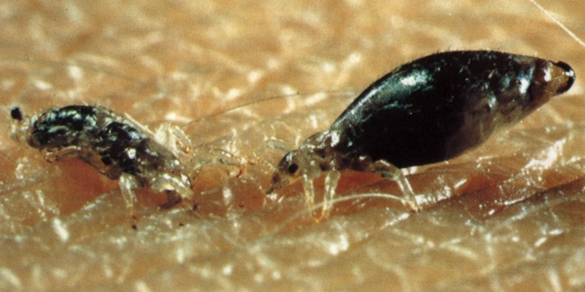
Entomology is the Study of Insects

Slide 3
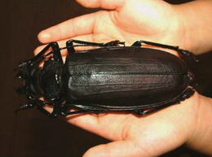
Insect Biology
Insects are the most diverse and abundant forms of life on earth.
There are over a million described species- more than 2/3 of all known organisms
There is more total biomass of insects than of humans.
Insects undergo either incomplete or complete metamorphosis (Egg to larva to pupa to insect)
Larva have a soft tubular body and look like worms. Fly species larvae are “maggots”

Slide 4
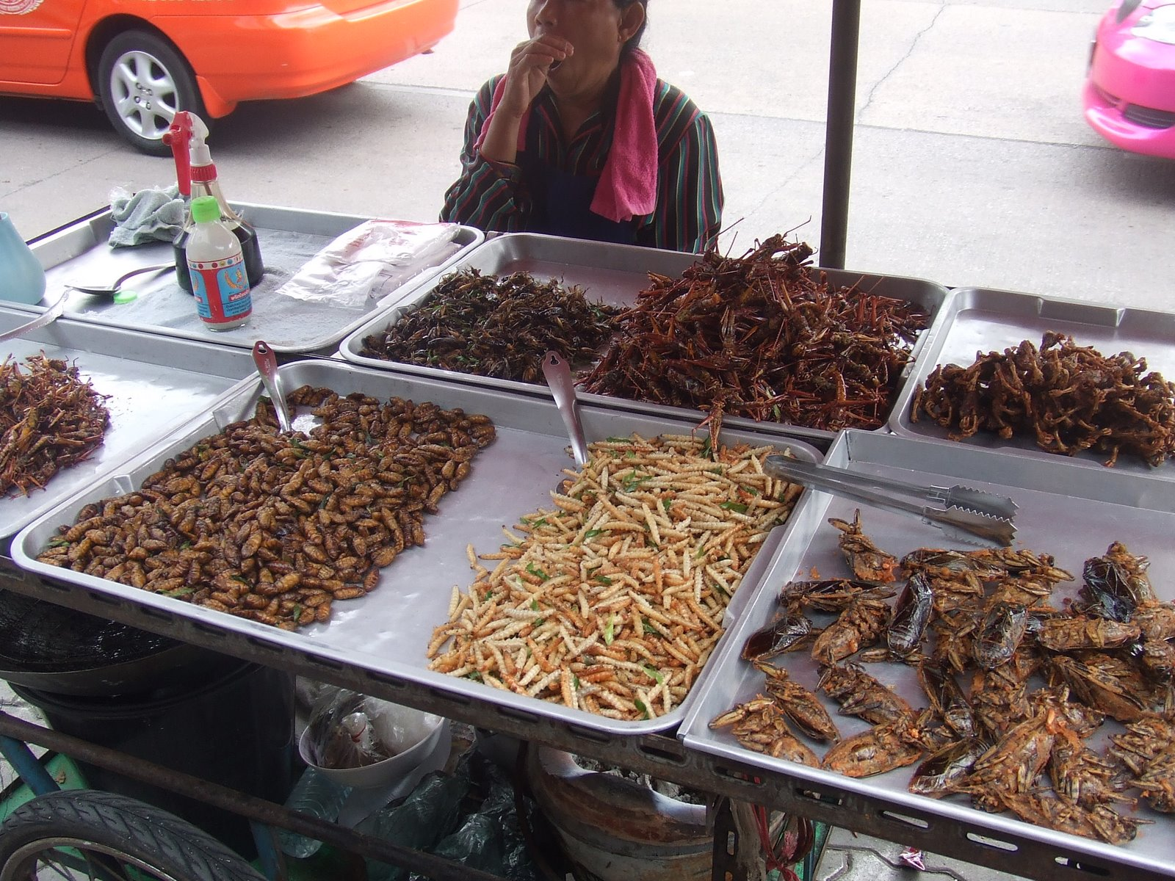
What is Forensic Entomology?
Forensic Entomology is the use of insects and other arthropods that feed on decaying remains to aid legal investigations.

Slide 5
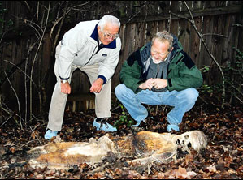
Most Important Environmental Factors in Corpse Decay
Temperature
Access by insects
Depth of Burial
“The Body Farm”

Slide 6
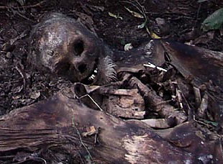
Postmortem interval (PMI)
Forensic Entomology is used to determine time since death (the time between death and corpse discovery)
This is called postmortem interval or PMI).
Other uses include
  movement of the corpse
  manner and cause of death
  association of suspects with the death scene
  detection of toxins, drugs, or even the DNA of the victim through analysis of insect larvae.

Slide 7
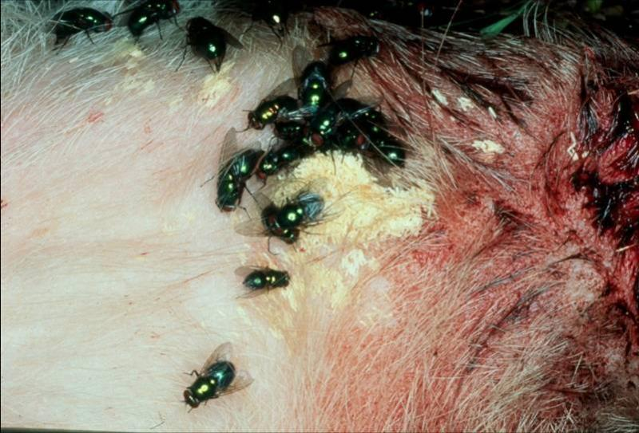
Forensic Entomology is Applied Biology
When an animal dies, female insects will be attracted to the body. They enter exposed orifices or wounds and lay eggs or larvae.

Slide 8
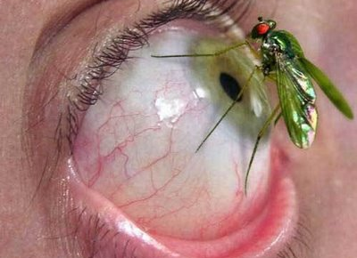
Ecology of Decomposition
Necrophages - the first species feeding on corpse tissue. Includes rue flies and beetles.
Omnivores - species such as ants, wasps, and some beetles that feed on both the corpse and associated maggots. Large populations of ominvores may slow the rate of corpse’s decomposition by reducing populations of necrophagous species.
Parasites and Predators - beetles, true flies and wasps that parasitize immature flies.
Incidentals – pill bugs, spiders, mites, centipedes that use the corpse as an extension of their normal habitat

Slide 9
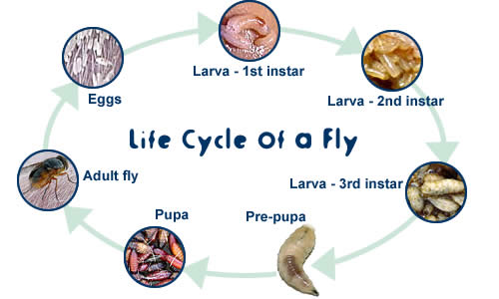

Slide 10

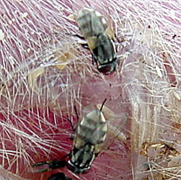
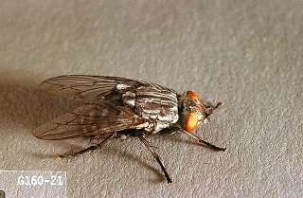
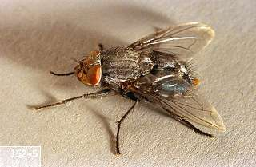
Forensic Entomology:
Flies
Sarcophagidae - flesh flies
  Adults lay larvae on decaying flesh
  Some of the first insect to reach a corpse
Calliphoridae – blowflies
  Different species have different habits –light vs. dark, urban vs. rural
  All have larvae that feed on corpses
  Also one of the first to arrive

Slide 11
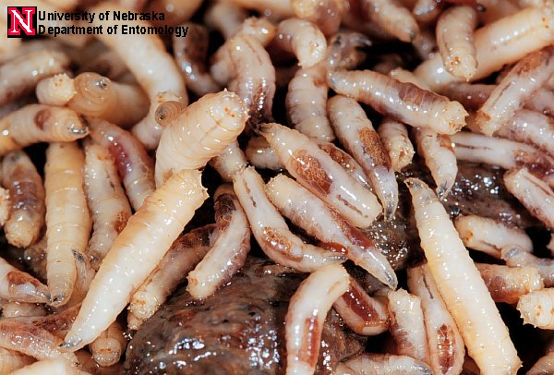
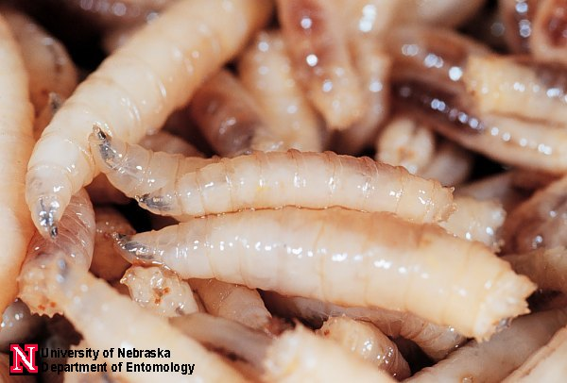
Blowfly Larvae

Slide 12
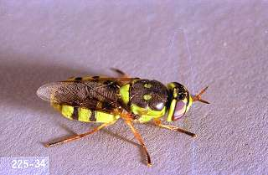
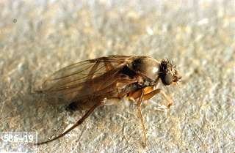
Forensic Entomology:
Flies
Strateomyidae – soldier flies
  Larvae feed on human excrement and remains
  Are found late in decomposition process
Phoridae – humpbacked flies
  Larvae feed on decaying bodies
  Some species can burrow to a depth of 50cm over 4 days
  Important in buried bodies

Slide 13
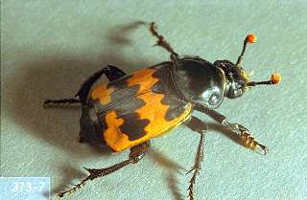
Forensic Entomology
Carrion beetles
Silphidae – Carrion beetles
  Buries small carcasses
  Adults feed on maggots and carrion

Slide 14
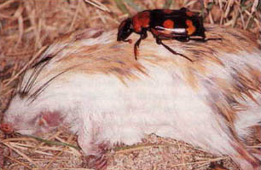
Female Carrion Beetle and Kangaroo Rat
Rat will be completely buried and eggs laid upon it.

Slide 15
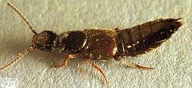
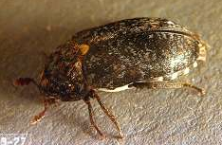
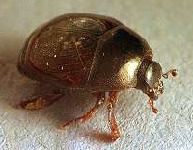
Forensic Entomology:
Beetles
Staphylinidae – rove beetles
  Arrive a few hours after a death
  Are active throughout decomposition process
Dermestids – Carpet beetle
  Larvae and adults feed on dry skin and hairs
Histeridae – Hister beetles
  Found in bloated, decay, and early drying stages
  Both larvae and adults feed on maggots and puparia

Slide 16
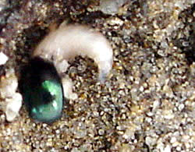
Hister Beetles Prey on Blowfly Larvae

Slide 17
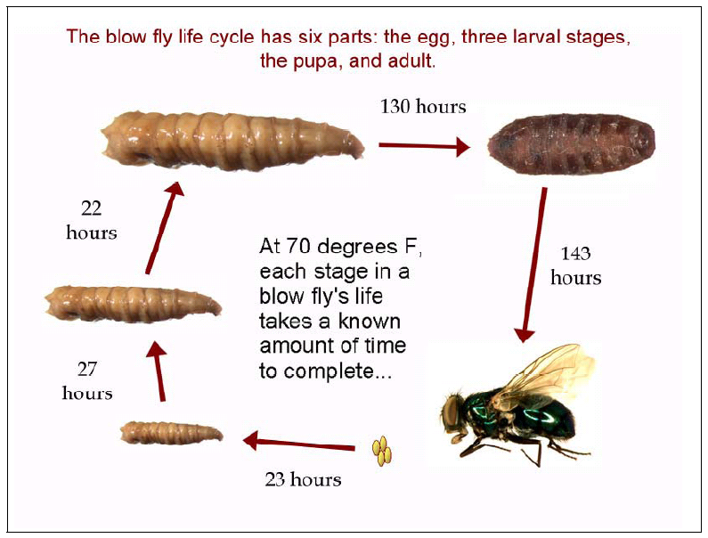
Image: http://www.nlm.nih.gov/visibleproofs

Slide 18
Five Stages of Decomposition Fueled by Insect Activity.
Fresh
Bloat
Decay
Post-decay
Dry (skeletal)

Slide 19
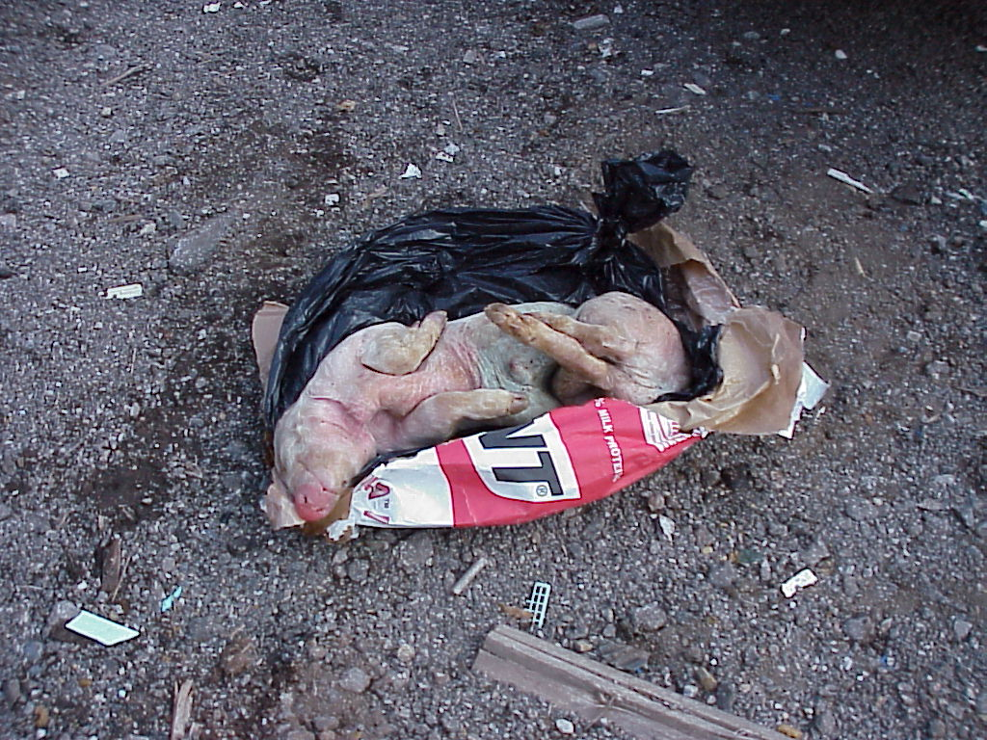
Fresh
Begins at death
Flies begin to arrive
Temperature falls to that of the ambient temperature.
Autolysis, the degradation of complex protein and carbohydrate molecules, occurs.
Notes:
Gasses produced by the metabolic activities of the anaerobic bacteria first cause a slight inflation of the abdomen. The carcass may later assume a fully inflated, balloon-like appearance. Adult and larval blowflies in large numbers attracted to fluids seeping from body, normal soil dwelling fauna depart soil because of seepage of fluids; some muscid flies and ants which can feed on larvae and retard maggot activity.

Slide 20
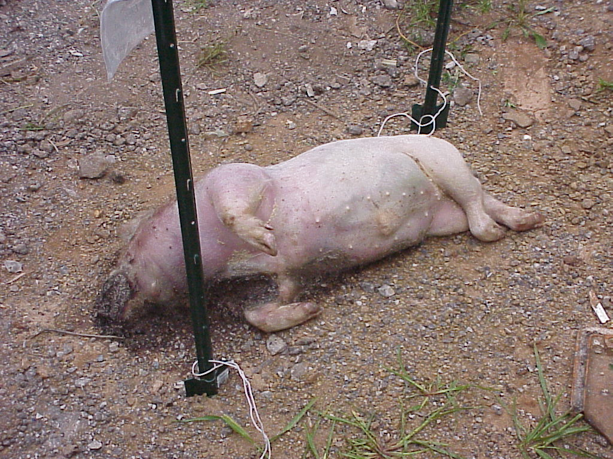
Bloat
Swells due to gases produced by bacteria
Temperature rise of the corpse
Flies still present

Slide 21
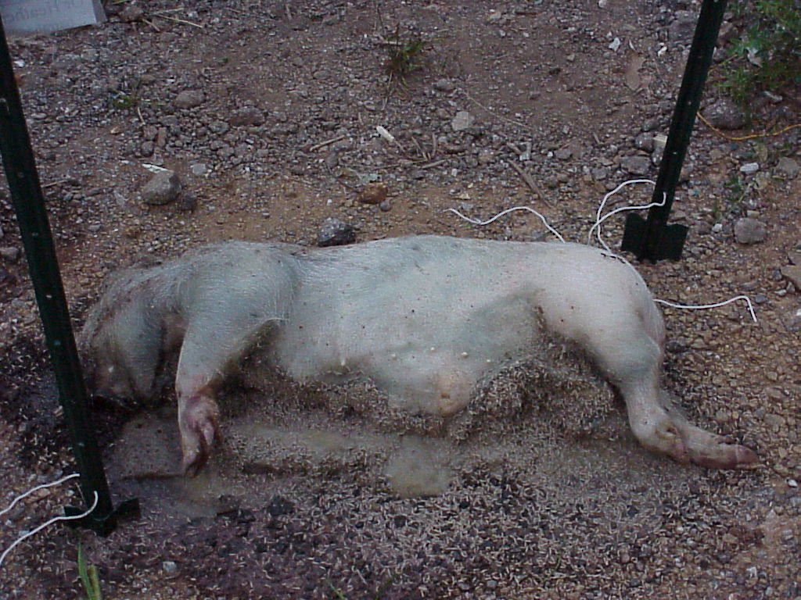
Decay
Gases subside, decomposition fluids seep from body.
Bacteria and maggots break through the skin.
Large maggot masses and extreme amounts of fluid.
Unpleasant odor
Larvae beginning to pupate.
Corpse reduced to about 20% of it’s original mass.
Notes:
Decay Stage - Black Putrefaction (Days 5-11) -- Decay stage begins when the abdominal wall is broken, allowing gasses to escape and carcass deflates. This process is facilitated by feeding activities of larval flies present on the exposed remains. Adult flies start to leave body, mainly larval mass. Carcass begins to assume a blackened, wet appearance, and most of the flesh will be removed by the maggots. Toward end of this period, carcass will begin to dry and beetles feed on drier tissue. Flies start to pupate. Predatory beetles such as rove beetles and histerids come to feed on other insects.

Slide 22
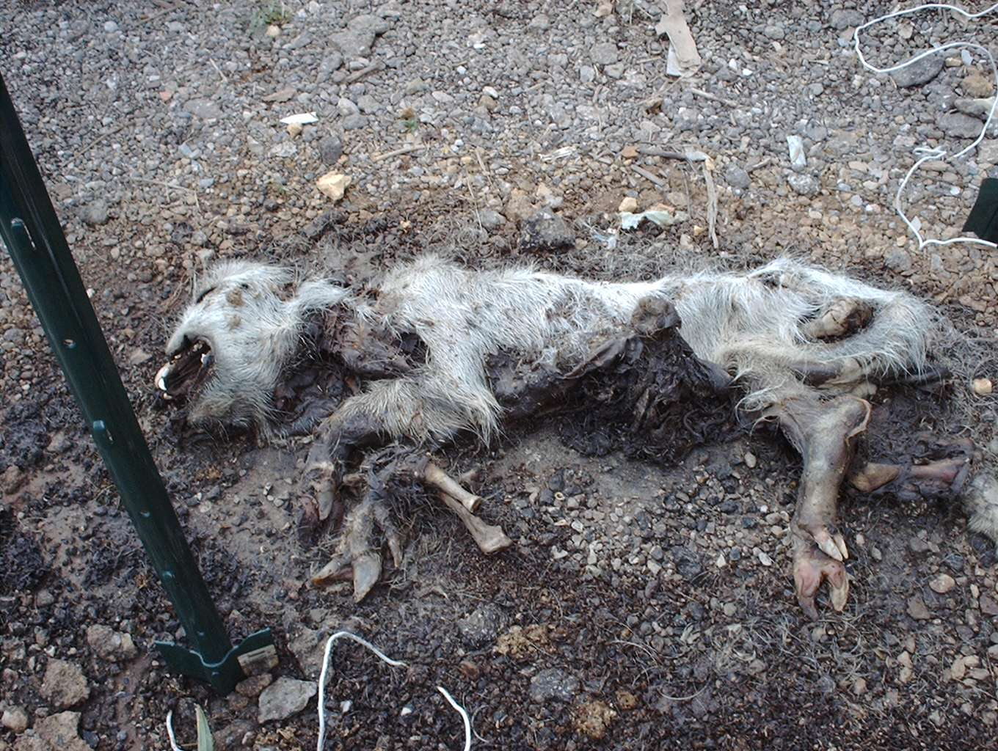
Post-Decay
Carcass reduced to hair, skin, and bones.
Fly population reduced and replaced by other arthropods.
Hide beetles are dominant in dry environments.
Mite and predatory beetle populations increase.
Notes:
Postdecay Stage - Butyric fermentation (Days 10-25) -- In dry habitats, remains consisted of dry skin, cartilage and bones. Site for dermestid beetles, histerids, fly pupae, immature and adult rove beetles. In wet habitats, a large quantity of wet, viscous material, termed byproducts of decomposition, was found in the soil under the remains. Site for immature and adult moth flies, sphaerocerid and muscid flies, rove beetles.

Slide 23

Dry (Skeletal)
Does not always occur especially if corpse is in a wet region. Maggots will stay longer and hide beetles will not appear.
In wet environments the hide beetles are replaced with nabid and reduviid insects.
The corpse is reduced to at least ten percent of the original mass.
In the last stage (Skeletal Stage), only bone and hair remain.
Notes:
Dry Stage (Days 25 +) -- This stage is reached when mainly bones and hair remain. Odor is primarily that of normal soil and litter. Some dermestid beetles, histerids, fly pupae, immature and adult rove beetles, normal soil fauna (mites) start to return. Can last several months to even years.

Slide 24
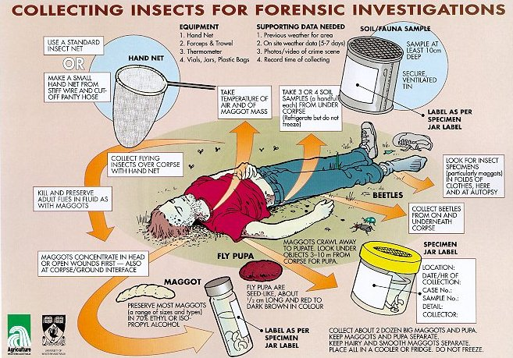

Slide 25
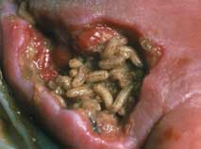
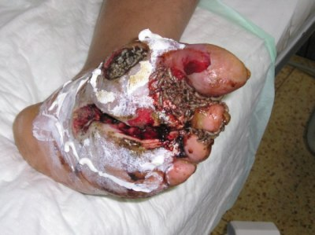
Interesting and True …
Maggot therapy is much more commonly used in Great Britain and Europe than in the U.S.
There have been about 25,000 treatments in Great Britain since 1995.
Ronald Sherman, M.D. is the pioneer of maggot therapy in the U.S. He is located at U. of Calif., Irvine.

Slide 26
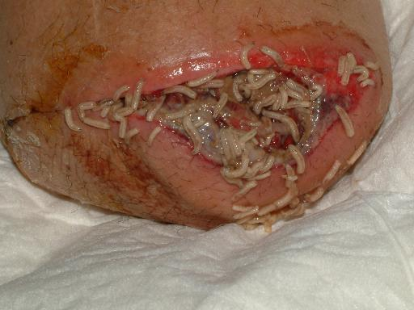
Maggots Cleaning Up a Wound Associated with an Amputation

Slide 27
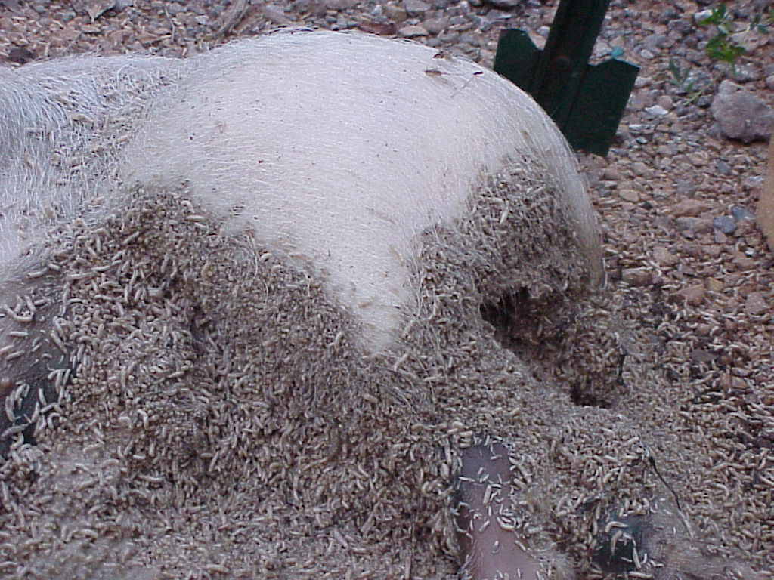
The End

