Slide 1
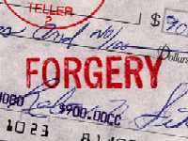
Document and Handwriting
Analysis

Slide 2
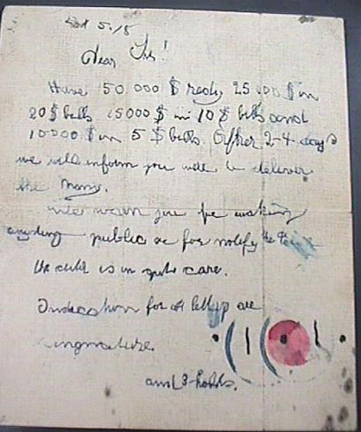
What is a questioned document?
Questioned document-
a document in its entirety or part that is suspect to its authenticity or origin

Slide 3
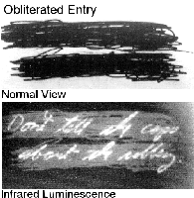
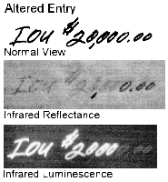
Questioned Documents
Involves the examination of handwriting, ink, paper, etc. to ascertain source or authenticity
Examples include letters, checks, licenses, contracts, wills, passports
Investigations include: verification, authentication, characterizing papers

Slide 4
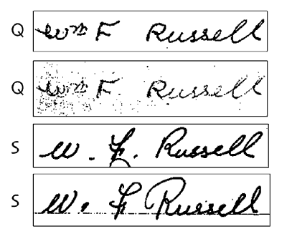
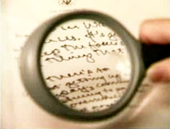
Document Examination
Forensic Document Examination
involves the analysis and comparison of questioned documents with known material in order to identify whenever possible, the author or origin of the questioned document.

Slide 5
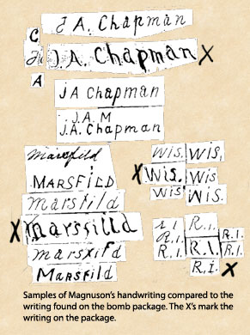
Exemplar
Exemplar-
Known handwriting sample from an individual
In early 1923, John Magnuson — Swedish immigrant to the United States, veteran of the Boer War, and Wisconsin farmer — stood accused of the bombing murder of Clementine Chapman, wife of the Wood County Drainage Board Chairman, James Chapman.
The blast that killed Clementine was meant for James, who was partly responsible for a controversial drainage project that cut through Magnuson’s farm. Magnuson hated Chapman and the Drainage Board and had publicly vowed to stop the project by any means necessary — including violence.

Slide 6
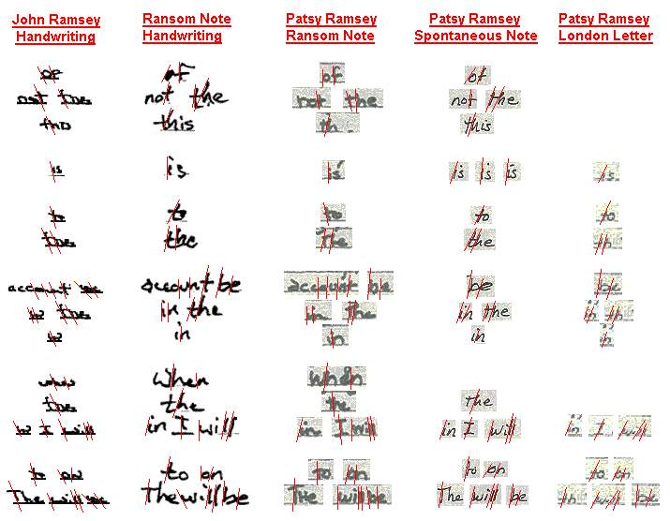

Slide 7
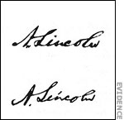
By John Cosey: one of the most infamous forgers of the 20th Century
By Abraham Lincoln

Slide 8
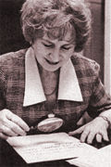
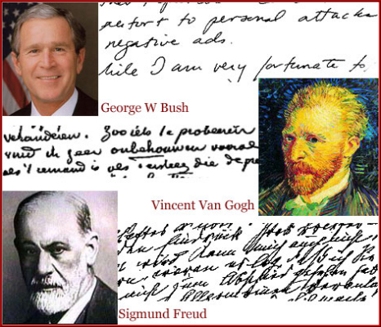
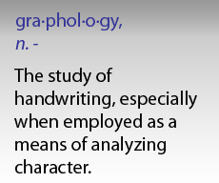
Graphology vs. Questioned document analysis
Associate personality with handwriting (pseudoscience)
Vs.
Peer-reviewed field of specialists

Slide 9

Handwriting
Development of handwriting
  Children’s writing is very similar.
  Handwriting becomes more individualized as a person ages.
  Handwriting in adulthood stays basically the same with only minor changes.
  Aoccdrnig to a rscheearch at Cmabrigde Uinervtisy, it deosn't mttaer in waht oredr the ltteers in a wrod are, the olny iprmoetnt tihng is taht the frist and lsat ltteer be at the rghit pclae. The rset can be a toatl mses and you can sitll raed it wouthit porbelm. Tihs is bcuseae the huamn mnid deos not raed ervey lteter by istlef, but the wrod as a wlohe.

Slide 10
Your Handwriting Style
“This means that the particular type of penmanship learned in early childhood leaves an impress upon the mind which influences greatly the writing of later years. The mature writing is of course modified by other factors, such as education, training, personal taste, artistic ability, musculature, nerve tone, and the like; but once the form of the letters and their manual execution have been crystallized by long usage, the identifying characteristics will undergo but slight if any change as time goes by.”
-Crime Science: Nickell & Fischer

Slide 11
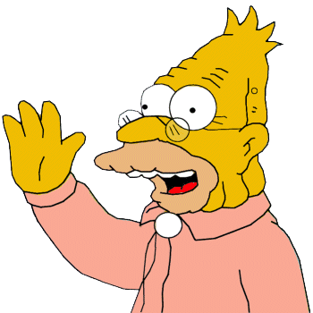
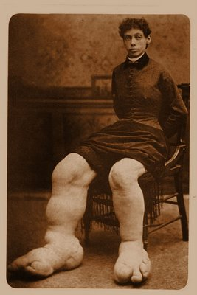
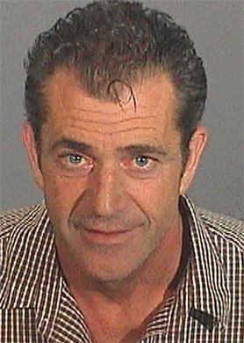

How can handwriting be affected?
Age
Illness
Drugs

Slide 12
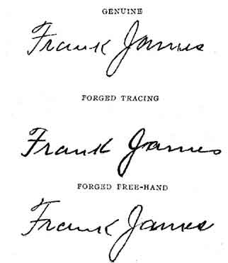
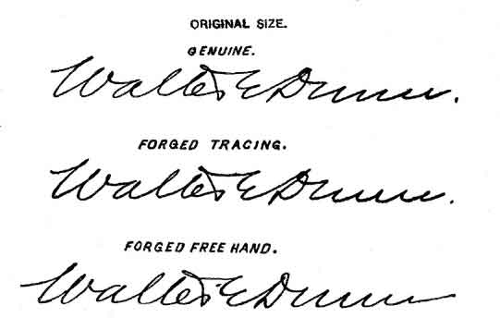
Methods of Forgery
Simulated forgery—one made by copying a genuine signature
Traced forgery—one made by tracing a genuine signature
Blind forgery—made without a model of the signature

Slide 13
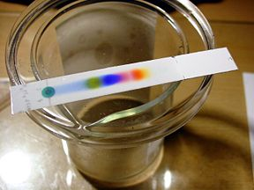

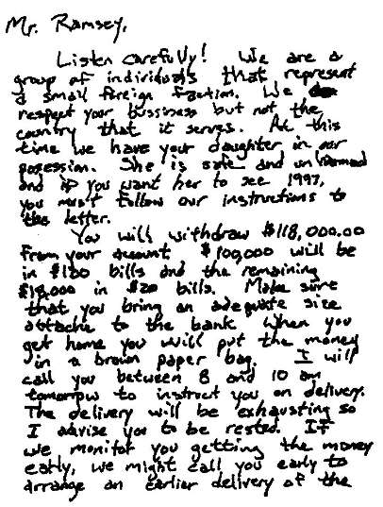
Handwriting
Handwriting analysis involves two phases:
  The hardware—ink, paper, pens, pencils, etc.
  Visual examination of the writing

Slide 14
Handwriting Characteristics
Line Quality
Word and Letter Spacing
Letter Comparison
Pen Lifts
Connecting strokes
Beginning and ending strokes
Unusual Letter Formation
Shading or pen pressure
Slant
Flourishes or embellishments
Diacritic (accent) Placement

Slide 15
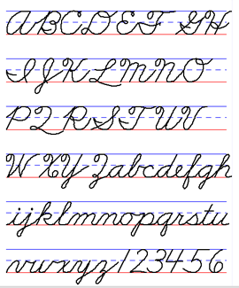
Common Writing Mechanics Examined
Each letter; how it is made, where it starts, ends
Letter spacing, word spacing
“I” dots
“t” crosses
Size ratio of letters
Slant

Slide 16
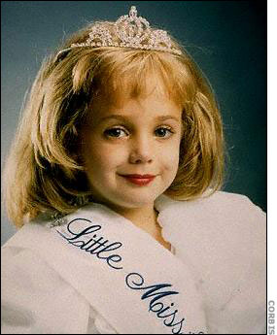
Grammar and spelling are also important clues…
“The misspelling of "bussiness" stands out as perhaps an intentional misspelling, to disguise the probability of the author having more education than the misspelling implies. The punctuation marks at appropriate intervals and the correct spelling and level of language of much of the rest of the note suggests a writer with educational/communication level above this type of language error.”
- Jon-Benet Ramsey case

Slide 18
Handwriting Identification
  Analysis of the “knowns” (exemplars) with a determination of the characteristics found in the known
  Analysis of the questioned or unknown writing and determination of its characteristics
  Comparison of the questioned writing with the known writing.
  Evaluation of the evidence, including the similarities and dissimilarities between the “questioned” and “known” writing
  The document examiner must have enough exemplars to make a determination of whether or not the two samples match.

Slide 19
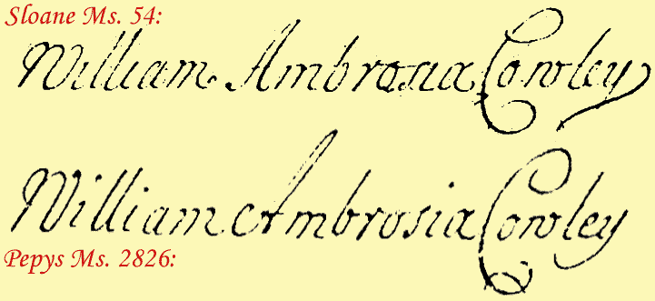
Types of Exemplars
1) Collected writings – everyday writings to friends, business papers, loan applications, bank forms, etc.
2) Requested writings – obtained voluntarily or through court order
Which is more reliable?

Slide 20
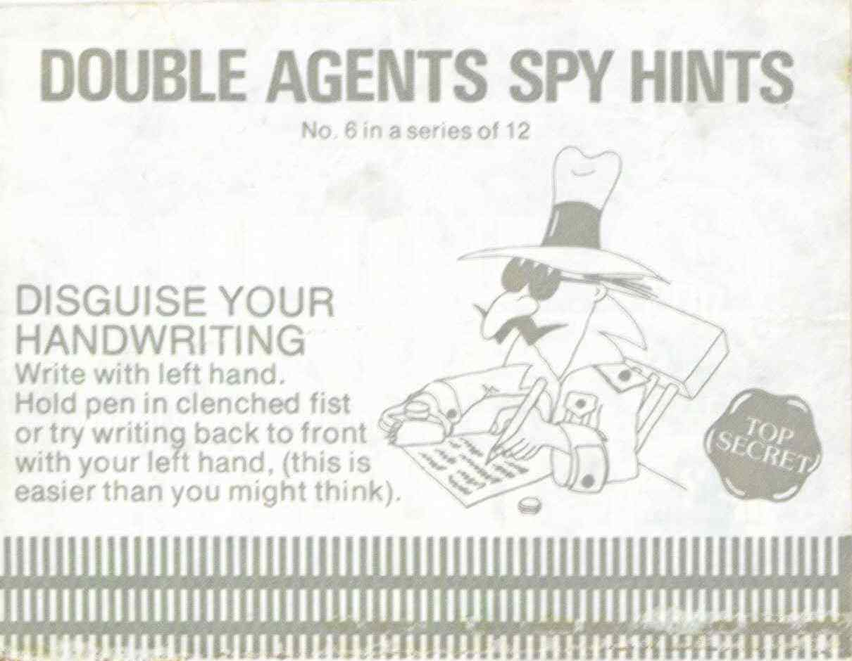
What is a potential problem with requested exemplars?
Trying to disguise natural handwriting

Slide 21
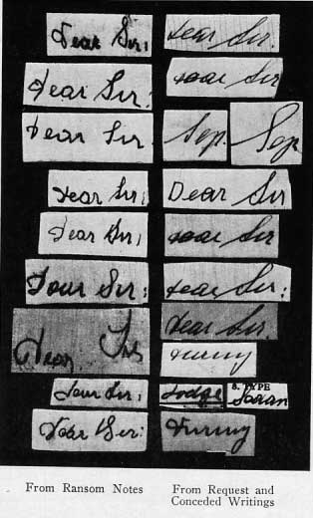
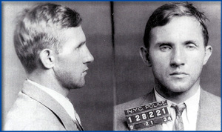
Obtaining Handwriting Samples
The subject should not be shown the questioned document
The subject is not told how to spell words or use punctuation
The subject should use materials similar to those of the document
The dictated text should match some parts of the document
The subject should be asked to sign the text
Always have a witness

Slide 22
Why would we dictate the text instead of letting them copy the document?
Cannot use the characteristics of the questioned document
Spelling, page layout, word spacing, line spacing

Slide 23
Activity
Write this 4 times on your note sheet:
“I will actually study for the next exam”

Slide 24
Important to Get Numerous Samples
Why?
Variation in daily writings
If trying to disguise writing, better chance that true writing characteristics will come out
Automatic nature of writing- brains programmed with our writing styles difficult to disguise

Slide 25
Steps to reduce specimen alteration
  Furnish the suspect with pen and paper similar to those used to create the questioned document
  Never show the suspect the questioned document
  Do not provide help with spelling, punctuation, capitalization, or grammar
  Dictate text that contains as many of the same words and phrases that appear in the questioned document as possible
  Dictate the text many times

Slide 26
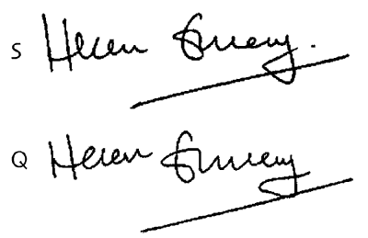
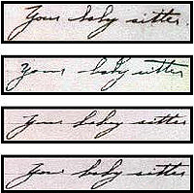
Signatures
Signatures are intentionally highly stylized and are never identical on two different occasions.
They are usually forged for financial gain.

