Slide 1
Forensics
Jeopardy
Mr. Wagner as himself

Slide 2
History | Fingerprint A | Prints | Fingers | Fin..Print

Slide 3
He surgically removed prints and grafted skin from his ribs
A-A1

Slide 4
Roscoe Pitts
Q-A1

Slide 5
The definition of forensic science
A-A2

Slide 6
What is the application of a broad spectrum of sciences to the legal system or courts?
Q-A2

Slide 7
Identification system based on precise measurements
A-A3

Slide 8
What is anthropometry?
Q-A3

Slide 9
They demonstrated the weakness of precise body measurements for identification
A-A4

Slide 10
Who are the “West brothers”?
Q-A4

Slide 11
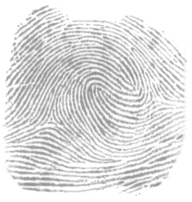
A-A5

Slide 12
What is a double loop whorl?
Q-A5

Slide 13
What does AFIS stand for?
A-B1

Slide 14
Automated fingerprint identification system
Q-B1

Slide 15
Prints that are not visible
A-B2

Slide 16
What are latent prints?
Q-B2

Slide 17
The “hills” of your fingerprints are called
A-B3

Slide 18
What are friction ridges?
Q-B3

Slide 19
What chemical reacts with amino acids in latent prints to form a purple color?
A-B4

Slide 20
ninhydrin
Q-B4

Slide 21
An organism that has fingerprints very similar to ours
A-B5

Slide 22
What is a koala or primate?
Q-B5

Slide 23
A print that you can see with your naked eyes
A- C1

Slide 24
What is a visible print?
Q-C1

Slide 25
What is secreted that allows prints to be developed?
A-C2

Slide 26
What are oils, ions, molecules, sweat?
Q-C2

Slide 27

A-C3

Slide 28
Ridge ending
Q-C3

Slide 29
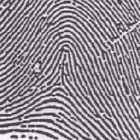
A-C4

Slide 30
What is an arch?
Q-C4

Slide 31
A print that is left in a soft substance as wax, putty, clay, etc.
A-C5

Slide 32
What is a plastic print?
Q-C5

Slide 33
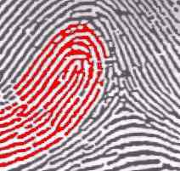
A-D1

Slide 34
What is loop?
Q-D1

Slide 35
What does AFIS allow investigators to do?

Slide 36
Search a database for fingerprints
Q-D2

Slide 37
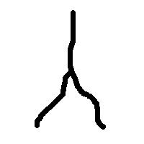
A-D3

Slide 38
What is a bifurcation?
Q-D3

Slide 39
A loop that opens toward the thumb
A-D4

Slide 40
What is a radial loop?
Q-D4

Slide 41
A loop that opens toward the pinky
A-D5

Slide 42
What is an ulnar loop?
Q-D5

Slide 43
What does developing prints mean?
A-E1

Slide 44
Making latent prints visible
Q-E1

Slide 45
What is the lowest primary classification value?
A-E2

Slide 46
What is 1/1?
Q-E2

Slide 47
A nation wide database of fingerprints
A-E3

Slide 48
What is AFIS?
Q-E3

Slide 49
Procedures for acquiring a latent print
A-E4

Slide 50
What is dusting, then lifting, then affixing to an appropriate backing?
Q-E4

Slide 51
The lowest possible primary classification value
A-E5

Slide 52
What is 1/1?
Q-E5

Slide 53
Final Jeopardy
Fingerprint history
Q’est-ce que c’est que.
S-Final

Slide 54
Final Jeopardy
Are you ready?
A-Final

Slide 55
Who tried to burn off his fingerprint patterns with acid?
Final Jeopardy
Q-Final

Slide 56
Daily Double
Daily Double

Slide 57
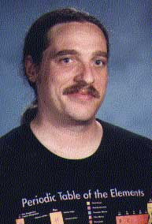

PowerPoint Jeopardy
Ver 2.2
Written by
Winston Riley IV
(WinstonRiley@WonderDogPrograms.com)
From
Wonder Dog Programs
(www.WonderDogPrograms.com)

Slide 58
INSTRUCTIONS

Slide 59
How To Set Up A New Game (Page 1)
You will need to come up with 25 answers followed by 25 questions in five different categories.
All the updates to this file are like any other changes you can make in a PowerPoint slideshow.
There are 25 pairs of pages waiting for you to enter your answers and questions. Each slide has a unique number in the lower left corner to help you keep track of which slide you are on. Since there are five categories the number starts with an A, B, C, D, or E, followed by a number within that category (1, 2, 3, 4, 5). The A- or Q- prefix indicates the position within a pair. So a slide that has A-C3 is the third category, third answer: it is the one in the very middle of the board.
You can page down or page up to the desired slide and change the text that is already there with your answer.
The category headings must also be changed on the game board slide. Do this by selecting the slide and clicking in the text you want to change. Note that the headings are in a table
More

Slide 60
How To Set Up A New Game (Page 2)
The first slide also has a title on it which should be changed to reflect the topic of the game you are making.
If you want to show a double Jeopardy answer select the slide and right-click on the black background. Choose ‘Background’ and select a red color for the background. Apply the background only to that slide. Repeat for the second slide.
That’s it. You are now ready to play PowerPoint Jeopardy.
IMPORTANT NOTE:
Do not rearrange the slides or delete them. There is VBA programming code within this slide show that relies on the slides being exactly where they are.

Slide 61
How To Play Jeopardy (Page 1)
Jeopardy is unusual in that the host (teacher) reads an answer and the players (students) must give the question. This means that the answers must clearly point to a unique question, and the players must phrase their responses with a “what is...” or “Who is...” etc.
A player asks for a category and a number of any available answers. The host reads the answer and the first person to raise their hand, once the question is finished being read, gets to respond with the question. If they are correct then they receive the number of points for that question (as shown on the game board) and they get to select the next answer. If they are wrong then any remaining players may raise their hand and respond.
(NOTE: If you have a particular way that this game works well in a classroom situation, please e-mail me at rriley.und5.umd.edu, so that I can include that here. Thanks)

Slide 62
F.A.Q. (Frequently Asked Questions) (Page 1)
Q) I keep getting error messages when I play, or the game board goes to the wrong slide.
A) You have rearranged the slide and the program code within this game is no longer valid. Try setting up the game using a new template.
Q) Nothing happens when I press the buttons.
A) You must ‘Enable Macros’ when the slide show is opened. This game relies on the macro code that lies behind each slide.
(NOTE: If you have any questions or comments about how this game works, please e-mail me at rriley.und5.umd.edu, so that I can include that here. Thanks)

Slide 63
thinkmusic.wav
dailydouble.wav
thinkmusic.wav

Slide 64
PowerPoint
Jeopardy

