Slide 1
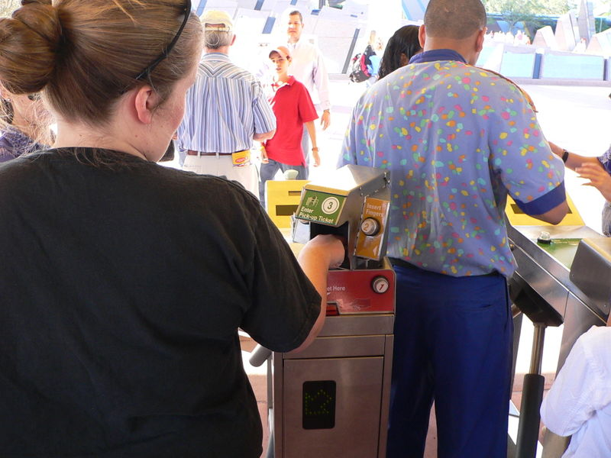
Biometrics
At Walt Disney World biometric measurements are taken from the fingers of guests to ensure that the person's ticket is used by the same person from day to day

Slide 2
Identification Methods
Traditional
  A person’s possession (e.g., key or card)
  A person’s knowledge of a piece of information (e.g., user id and password)
Biometrics
  A person’s physical characteristics (e.g., fingerprints, face, and iris)

Slide 3
Biometrics
Any human physiological or behavioral characteristic could be a biometric provided it has the following desirable characteristics:
  Universality: every person should have the characteristic.
  Uniqueness: no two persons should be the same in terms of the characteristic.
  Permanence: the characteristic should be invariant with time.
  Collectibility: the characteristic can be measured quantitatively.
  Performance: the resource requirements to achieve an acceptable identification accuracy.
  Acceptability: to what extent people are willing to accept the biometric system.
  Circumvention: how easy is to fool the system by fraudulent techniques.

Slide 4
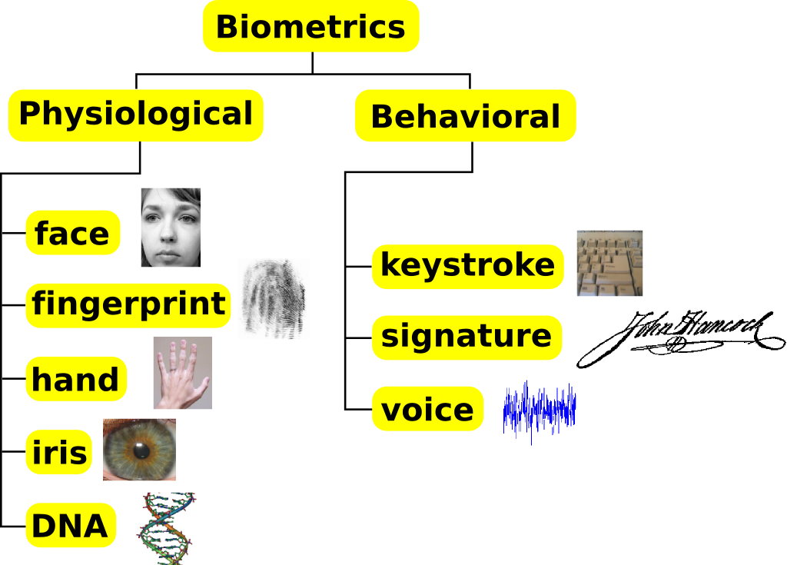
Some Biometric Methods

Slide 5
Biometrics Technologies
Voice
Infrared Facial and Hand Vein Thermograms
Fingerprints
Face
Iris
Ear
Gait
DNA
Signature and Acoustic Emissions
Retinal Scan
Hand and Finger Geometry

Slide 6
Voice – Pros and Cons
Pros
  Voice capture is unobtrusive and voice print is an acceptable biometric in almost all societies.
  Some applications entail authentication of identity over telephone.
Cons
  Voice is not expected to be sufficiently unique to permit recognition.
  A voice signal available for authentication is typically degraded in quality by the microphone, communication channel, and digitizer characteristics.
  Voice is a behavioral characteristic and is affected by a person’s health (e.g., cold), stress, and emotions.
  Some people are very good at mimicking the voice of others.

Slide 7
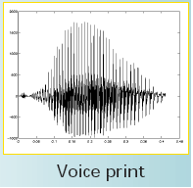
Voice - Methodology
The amplitude of the input signal may be normalized and decomposed into several band-pass frequency channels.

Slide 8
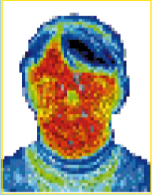
Infrared Facial and Hand Vein Thermograms –
Pros and Cons
Pros
  Human body radiates heat and the pattern of heat radiation is a characteristic of each individual body.
  Infrared Imaging is unobtrusive.
Cons
  The absolute values of the heat radiation are dependent upon many extraneous factors.
  The technology is expensive.

Slide 9
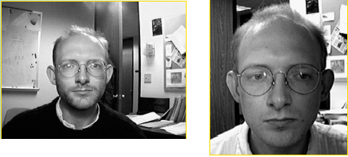
Face – Pros and Cons
Pros
  Face is one of the most acceptable biometrics because it is one of the most common method of identification that humans use.
  It is non-intrusive.
Cons
  Difficult to develop techniques to tolerate the effects of aging, facial expressions, slight variations in the imaging environment, and variations in the pose of face with respect to camera (2D and 3D rotations).
  Facial disguise is of concern in unattended applications.

Slide 10
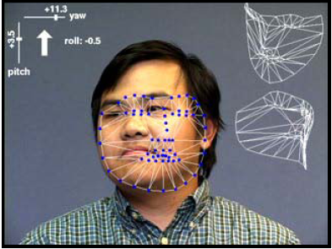
Face Recognition
Model-Based Face recognition
Notes:
Simon Baker, Robotics Institute, Carnegie Mellon University

Slide 11
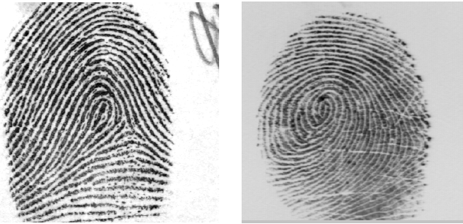
Fingerprints - Acquisition
A fingerprint image is captured in one of two ways:
  Scanning an inked impression of a finger
  Using a live-scan fingerprint scanner.

Slide 12
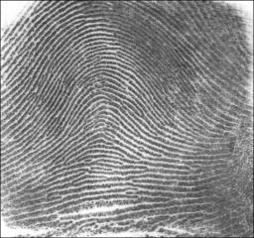
Fingerprints – Pros and Cons
Pros
  It is one of the most mature biometric technologies.
  Fingerprints are believed to be unique to each person.
Cons
  It has a stigma of criminality.

Slide 13
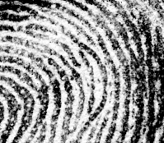


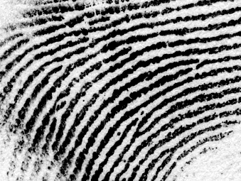


Biometrics: forms
Fingerprints
  identify minutia
Enclosure
Ridge ending
Island
Bifurcation

Slide 14
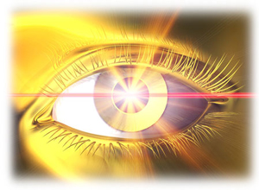
Eye Recognition

Slide 15
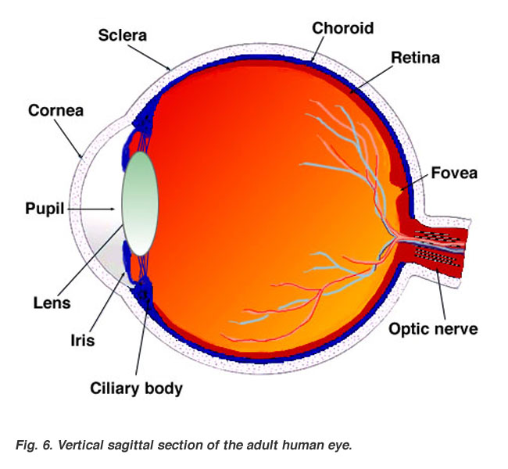
Eye Recognition

Slide 16
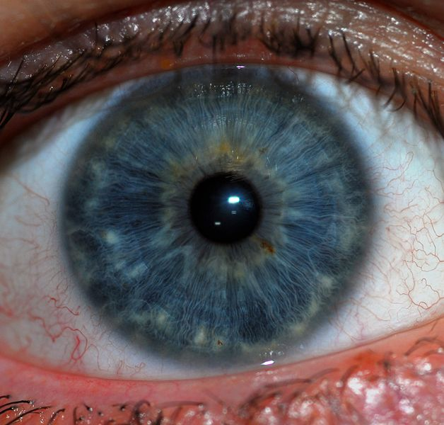
Eye Recognition
Iris
    Colored part of eye
266 identifying characteristics
    Fingerprint has 60-70
Eyelashes, light, eyelids, and reflections can all affect reading
Afghanistan
Notes:
According to Peter Higgins, a biometrics consultant, the most widespread use of iris biometrics to date has been in Afghanistan, where the United Nations High Commissioner for Refugees (UNHCR) is using iris scans to attempt to prevent refugees from collecting benefits more than once

Slide 17
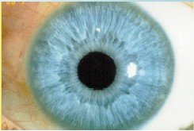
Iris – Pros and Cons
Pros
  It is unique for each person and each eye.
  The identification error rate using iris technology is believed to be extremely small and the method is very fast.
Cons
  It requires cooperation from the user.

Slide 18
Biometrics: desirable characteristics
Robustness
  Repeatable, not subject to large changes
Distinctive
  Wide differences in the pattern among population
Fingerprints: highly distinctive, not very robust
Fingerprints: typically 40-50 distinct features
Irises: typically >250 distinct features
Hand geometry: highly robust, not very distinctive
(~1 in 100 people might have a hand with measurements close to yours)

Slide 19
Irises vs. Fingerprints
Number of features measured:
  High-end fingerprint systems: ~40-60 features
  Iris systems: ~240 features
Ease of data capture
  More difficult to damage an iris
  Feature capture more difficult for fingerprints:
    Smudges, gloves, dryness, …

Slide 20
Irises vs. Fingerprints
False accept rates
  Fingerprints: ~ 1:100,000 (varies by vendor)
  Irises: ~ 1:1.2 million
Ease of searching
  Fingerprints cannot be normalized
  *many searches are difficult
  Irises can be normalized to generate a unique IrisCode
  *many searches much faster

Slide 21
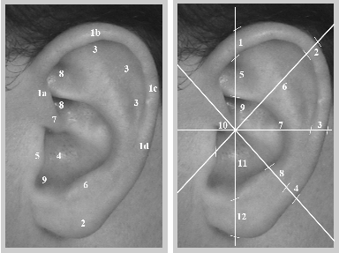
Ear – Pros and Cons
Pros
  It is known that the shape of the ear and the structure of the cartilegenous tissue of the pinna are distinctive.
Cons
  The features of an ear are not expected to be unique to each individual (good for authentication only).
  No commercial systems are available yet.

Slide 22
Gait – Pros and Cons
Pros
  Non-obtrusive.
Cons
  Gait is not supposed to be unique to each individual, but is sufficiently characteristic to allow identity authentication.
  Gait is a behavioral characteristic and may not stay invariant over a large period of time (e.g., fluctuations of body weight or injuries involving joints or brain).

Slide 23
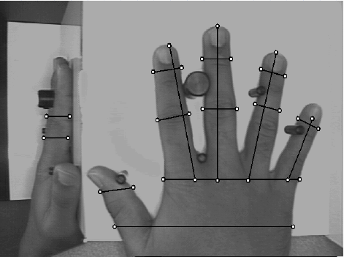
Hand Geometry

Slide 24
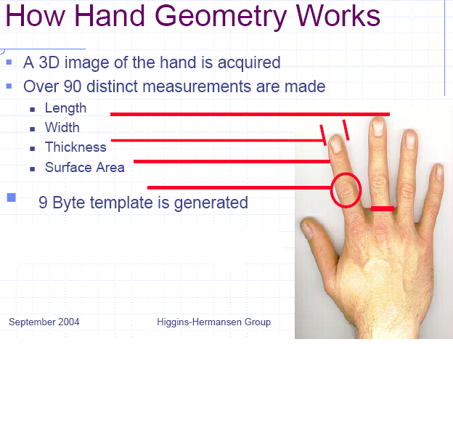
Hand Geometry

Slide 25
The end.

